Slide 1
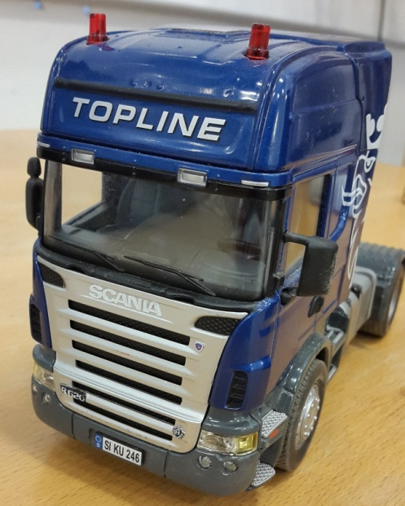
Decentralized Control of Truck Vehicles
Johan Clemedson and Elin Karlsson
2015-08-28

Slide 2
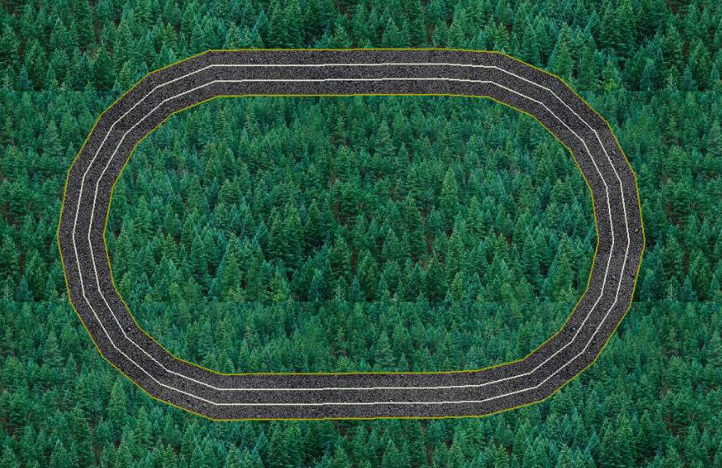
Introduction
Design controller for mini trucks
Platoons
Autonomous driving
Notes:
Elin
We have been working with developing controllers for mini trucks in the smart mobility lab. As you know, by driving in a platoon with small distances between the trucks you can decrease the fuel consumption and you can also improve the use of road space. But the small distance between the trucks demands autonomous control of the trucks.
You heard about this from the Felix and Magnus, who has been working with the communications between the vehicles. Our part was to integrate the mini trucks in the simulated world, where they can communicate with each other and the simulated cars.
Our goal was thus to develop controllers that makes the mini truck follow a certain trajectory and keep a desired velocity or follow another truck in a platoon.
* Skulle vilja lägga in en bild på bilen redan här ?

Slide 3
Qualisys
Motion capture system
Uses 12 cameras
Gives Truck positions:
X
Y
Yaw:
Global coordinate system

Slide 4
NI myRIO board
Reconfigurable I/O (RIO) technology
Programmable with LabVIEW or C
Connected to the trucks radio controller.
Notes:
Bild på en av våra RIOs.

Slide 5
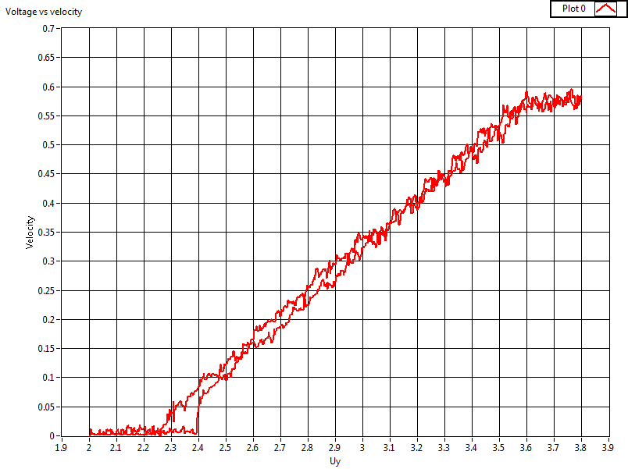
Cruise control
Implemented on myRIO device
PI control
Estimated velocity
Relation between voltage and velocity
Notes:
Elin
The cruise control is implemented on the myRIO device and designed to make the truck keep a velocity reference. The cruise controller is a PI controller. The velocity of the truck is based on an estimation of the current velocity that is calculated from the position of the truck at certain times. The period of the samples can vary slightly, and to get a good estimation it is important to use the actual time of the sample. The estimated velocity is calculated 20 times per second, and we used a median filter to decrease the noise.
All cars are unique, and they have different relations between the applied voltage and the velocity. To be able to control the velocity in a good way, we did tests where the velocity was estimated while a triangular voltage was applied as a voltage command. The steering voltage was kept constant. This resulted in graphs like this one *BILD*. First, the voltage is increased, resulting in the lower graph. Then the voltage is decreased, giving us the other part. As we can see, we have a resistance when the truck starts to drive, which means that we have to apply a higher voltage to make the truck move than to keep it moving. This will affect the behavior of the truck when using the cruise control, but in our work the effect was small enough so that we didn’t need to consider this.

Slide 6
Path control
d – distance to
closes point
e_{θ} – angular error,
e_{θ}=θ_{r} – θ
e_{L} – Lateral error.
e_{L,ahead} – Look ahead
Lateral error.
Trajectory

Slide 7
Path control
Low level control on myRIO
Based on different errors - Theta - Lateral - Ahead lateral
PID control
Notes:
Johan

Slide 8
Path Control
Trajectory between the two lanes
New trajectory

Slide 9
Keep Distance Control
PID control
Based on current and desired distance along the trajectory
New distance keeper based on velocity
2
1
3
Notes:
Elin
This controller is also implemented on the myRIO device, and is also a PID controller. It is based on the current distance to the point that we want to follow and the desired distance. The distance is always calculated along the trajectory since we always want the truck to keep in the lane.

Slide 10
Supervisory Layer and Communication
Parameters from supervisory layer - desired velocity - desired lane - desired and current distance
Emergency vehicle scenario - offset
Notes:
When implementing the controllers for our trucks together with the simulated world and the communication from Felix and Magnus project, we had to modify parts of our work. The program from which we reveived the position didn’t work, so they had to send us the position of each truck together as well as the time related to each sample together with the other information. We received the desired velocity for each truck, the desired lane and the desired and current distance to the truck that should be followed if the truck is in a platoon.

Slide 11
Demo
Platooning
Overtaking
Avoiding obstacle
Emergency vehicle
Notes:
In a while we will show you the result of our work in the Smart Mobility Lab. We will show you how the trucks can create a platoon, overtake each other and avoid an obstacle as well as give space for an emergency vehicle.

Slide 12
Questions? Thank you!
Notes:
Om någon frågar: 0.5 mm i x, 0.4 mm i y och 0.15 grader i theta enligt Ruis rapport ”mini trucks”

Slide 13

Emergency Vehicle Scenario

Slide 14
Keep Distance Control

Slide 15
Merge Platoons

